Slide 1


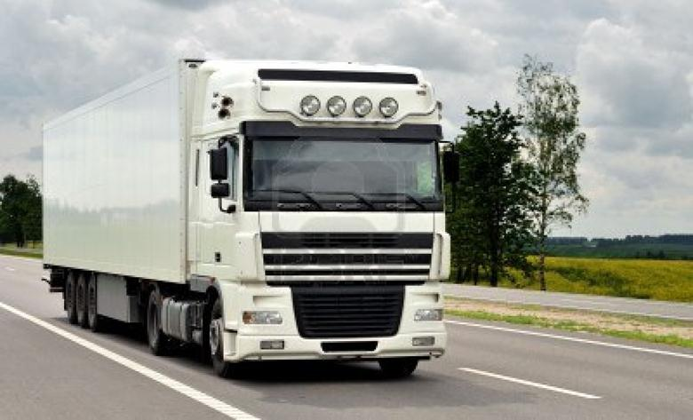
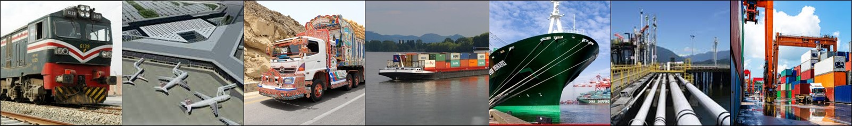
Ministry of Communications
National Transport Research Centre
Logistics in Pakistan
  Chief, NTRC
27th October, 2022
Islamabad

Slide 2
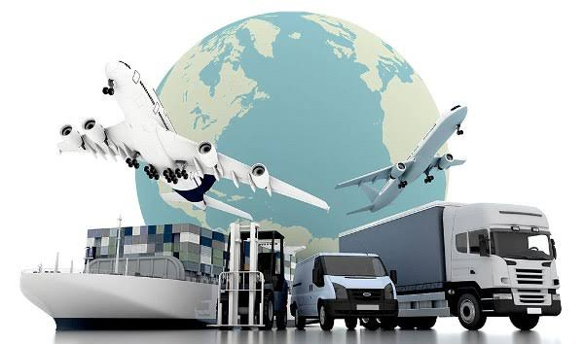
Sequence
  National Freight & Logistics Policy
  Transport Sector

Slide 3
NATIONAL FREIGHT & LOGISTICS POLICY

Slide 4
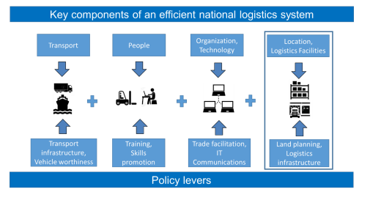
LOGISTICS
According to the Council of Supply Chain Management, Logistics is that part of supply chain management that plans, implements and controls the efficient, effective forward and reverse flow and storage of goods, services and related information between the point of origin and the point of consumption in order to meet customers' requirements. (Council of Supply Chain Management, 2013)
Logistics is the integration of transport, warehousing, freight forwarding, and information services.

Slide 5
LOGISTICS
By directly improving competitiveness of products and services, efficient, smooth, and low-cost logistics services make a significant contribution to the economy and to people’s livelihoods and national prosperity.
Transport Sector contributes 13% of GDP & 5.4% of total jobs in Pakistan’s economy

Slide 6
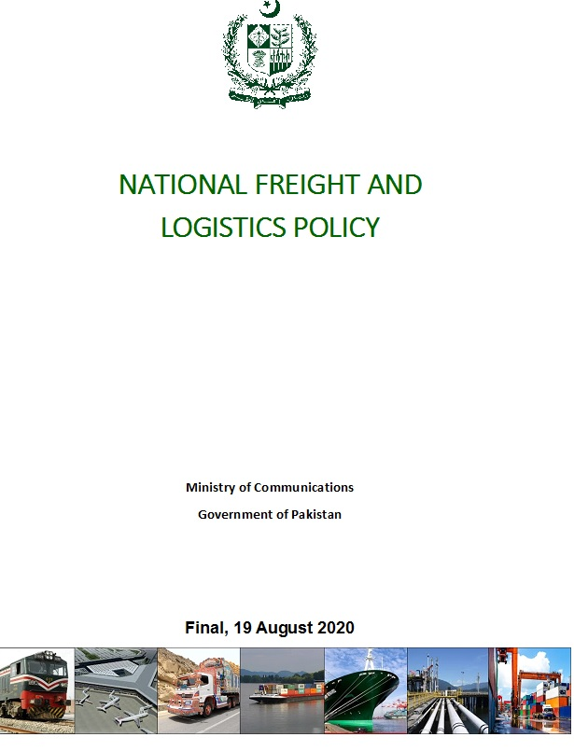
STRUCTURE of the POLICY
1
Introduction
2
State of the Pakistan’s Freight and Logistics Sector
3
Justification for the NFLP
4
Vision, Principles and Objectives
5
Policy Actions
6
Implementation, Monitoring and Evaluation

Slide 7
ROAD TRANSPORT SECTOR
Major Impediments
A largely obsolete truck fleet:
  Causes problems of road safety (drivers are poorly trained)
  Has poor fuel efficiency (transport consumes 35% of all energy in Pakistan)
  Promotes overloading which damages roads
  Does not meet certification requirements under TIR and cannot be used to transport goods across borders
Physical and non-physical bottlenecks
  Port access in Karachi and Port Qasim are an issue
  Rail is virtually non-existent
Laws governing transport sector need updating and harmonization
  Carriage of Goods by Road Act (COGRA), was prepared in 2003 but never approved
  Trucking Policy of 2008 identified the need for change in the sector, but was partially adopted
  Legal environment in which sector operates needs to be updated to permit operations in line with standard practices globally
Development of CPEC corridor, Accession to TIR will increase competition pressure on Pakistan’s freight and logistic sectors

Slide 8
Core Transportation Modalities (Road, Rail, Maritime)
Policy
Procedural
Infrastructure
Revise Trucking Policy 2007
Provincial Motor Vehicle Ordinance 1965
Tyres, lubricants, fuels
Axle Load Regime
Road Consignment Note
Registration of Drivers
Registration of heavy vehicles
Road-side facilities / resting areas
Weight-Bridges
Bonded warehouse for imported vehicles
Road
Rail
Railways Laws 1890
PR Freight Transportation Company
Extend operating hours
Market-driven tariffs
ML-1
Havelian Dry Port / KPK
Rail-seaport connectivity
Rail-SEZ connectivity
Maritime
Expand roles and mandates of KPT and PQA to include investment and training
Future concessions to consider shipping alliances
Incentives for industries development at Gwadar
Gate Controls
Over-sized/over-weight cargoes
Adoption of FIATA FBL and FWB
New access road to SAPT
Barge solution for Karachi-Qasim transfer in future
Relocate logistics facilities to Northern Bypass
New access road to SAPT
Second Channel for Qasim
Toll solutions on passengers traffic for flyovers

Slide 9
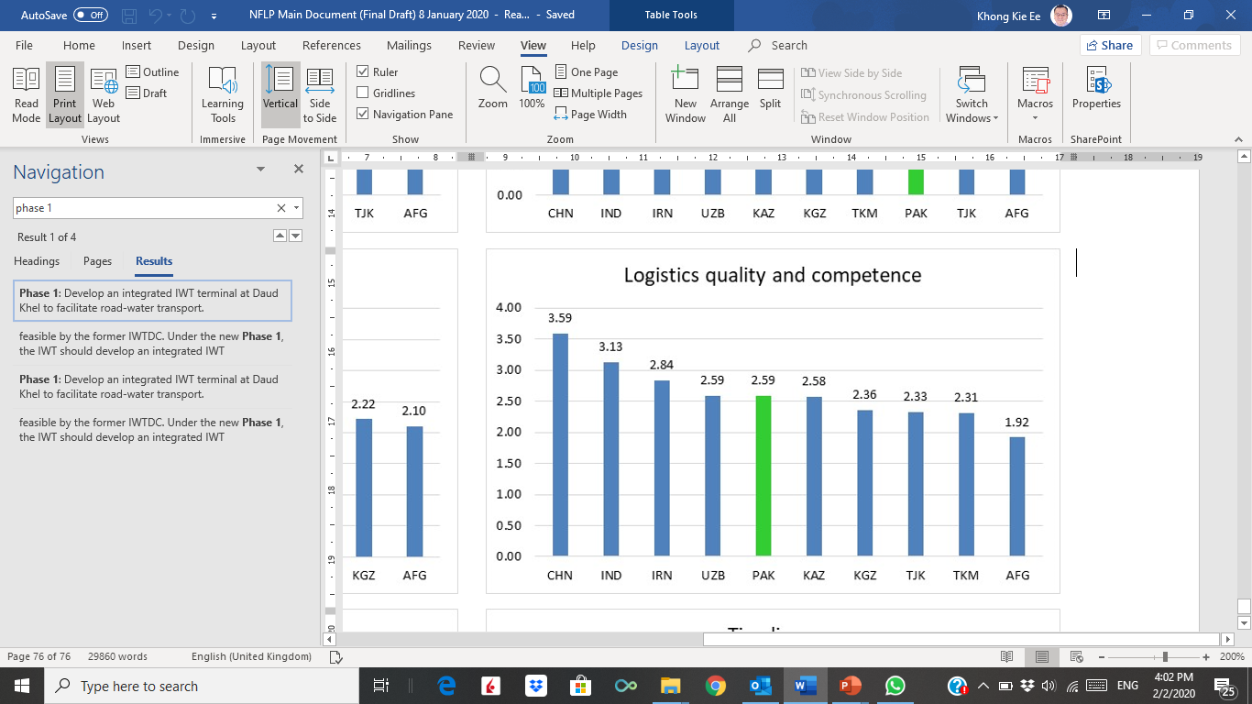
IMPLEMENTATION OF THE NATIONAL FREIGHT AND LOGISTICS POLICY
Ministry of Communications leading on the implementations.
NFLP Steering Committee and Working Group with private sector representation guided the progress of implementation.
Logistics Performance Indicators to confirm Monitoring and Evaluation.
Statistics collected and published by the National Transport Data Observatory and Pakistan Bureau of Statistics

Slide 10
Transport Sector of Pakistan

Slide 11
ROLE OF TRANSPORT SECTOR
Transport allows people to access jobs, markets, social interaction, education, and other services, thus enabling people to rise out of poverty and overcome social exclusion.
Transport adds value to goods brought to markets, links rural areas to cities and global supply chains, driving economic development.
Enhanced national integration of the country.
Cultural integration.
A well functioning Transport Sector is a pre-requisite for country’s development.
Transport is a key driver of socioeconomic development.

Slide 12
SUB - SECTORS
Roads
Aviation
Inland water
Ports & Shipping
Railway

Slide 13
TRANSPORT ASSETS
Number of Vehicles -- 31.0 million
Total Roads -- 500,748 Km
Motorways -- 2471 Km
National Highways -- 11,321 Km
Provincial Road Network -- 487,362km
Rail Tracks -- 7,791 km
Railway Locomotives -- Total 470 (458 Diesel & 12 Steam Engines).
Airports -- 7 major airports handling passengers & cargo
Dry Ports -- 15 dry ports/ border terminals
Sea Ports -- 3 commercial sea ports
Source: Bureau of Statistic

Slide 14
ROAD DATA COMPARISON
UNIT 1947 2021
REGD VEHICLES NO 30,577 30,968,000 ⁺
REGD TRUCKS/TRAILERS NO 800 300,000+
TOTAL ROADS KM 50,367 500,000⁺
MOTORWAYS KM NIL 2500+
NATIONAL HIGHWAYS KM NIL 12,000
Total area of Pakistan KM² - 862,069
ROAD DENSITY KM/KM² 0.06 0.58

Slide 15
ROAD LENGTH
Total: 500,748 KM
 | Motorways | Expressway | National Highways | Highways | Primary Road | Secondary Roads | Local Road | Metro Road
Total | 2,471 | 428 | 10,500 | 21,672 | 4,388 | 87,764 | 373,525 | 77
Source: NTRC Digital Maps

Slide 16
ROAD LENGTH
Total: 500,748 KM
Source: NTRC Digital Maps

Slide 17
VEHICLES ON ROAD
Summary of Motor Vehicles on Road in Pakistan
 | Mcy / Scooter | Motor Car | M.Cab / Taxi | Motorcycle/ Motor Rickshaw | D.Van | Pickup | Jeep / D.Cabin | Station Wagon | Ambu-lance | Buses / Mini Bus | Truck | Tractor | Oil Tanker | Other | Total
 | 1 | 2 | 3 | 4 | 5 | 6 | 7 | 8 | 9 | 10 | 11 | 12 | 13 | 15 | 16
2016-17 | 11,975,304 | 6,954,000 | 197,400 | 122,000 | 204,200 | 176,400 | 69,582 | 201,900 | 5,700 | 156,300 | 276,200 | 1,430,100 | 14,843 | 74,700 | 21,858,629
2017-18 | 14,060,885 | 7,183,500 | 197,711 | 128,100 | 210,100 | 187,200 | 80,000 | 206,600 | 6,900 | 159,224 | 280,000 | 1,460,200 | 15,200 | 92,400 | 24,268,020
2018-19 | 21,268,750 | 3,813,200 | 205,296 | 638,100 | 212,368 | 498,067 | 143,645 | 209,976 | 8,330 | 162,552 | 301,910 | 610,717 | 20,300 | 283,100 | 28,376,311
2019-20 | 22,808,822 | 3,960,188 | 116,107 | 721,290 | 139,861 | 513,485 | 150,892 | 93,100 | 8,780 | 193,715 | 309,600 | 627,993 | 24,331 | 287,150 | 29,955,314
2020-21 | 23,701,800 | 4,048,700 | 116,500 | 767,700 | 141,350 | 521,650 | 155,200 | 91,315 | 9,100 | 165,000 | 313,300 | 636,000 | 22,000 | 289,100 | 30,978,715
Source: * Excise & Taxation Department, Motor Registration Authority of all provinces. NTRC has complited, computerized and disiminated the said information.

Slide 18
NATIONAL TRANSPORT POLICY
The nation’s transport vision is to “provide safe, affordable, efficient, durable, and environmentally friendly means of transport, ensuring reliable access to jobs, markets, education, and other services for all.”
NTP - 2018

Slide 19
TRANSPORT MODAL SHARE IN PAKISTAN 2020
In Billion
Year | Vehicle - km | Passenger - Km |  |  | Ton-Km
 | Total | Total | By Road | By Rail | Total | By Road | By Rail
1995 | 16 | 145 |  |  | 75
2000 | 18 | 150 |  |  | 80
2005 | 20 | 155 |  |  | 99
2010 | 28 | 200 |  |  | 135
2015 | 35 | 235 |  |  | 150
2020 | 50 | 295 | 94% | 6% | 195 | 95% | 5%
2025 | 62 | 363 | 91% | 9% | 230 | 86% | 14%
2030 | 77 | 442 | 90% | 10% | 290 | 78% | 22%

Slide 20
TRANSPORT MODAL SHARE IN PAKISTAN
94%
95%
100
90
80
70
60
Passenger Traffic
%
50
Freight Traffic
40
30
6%
3%
20
0%
2%
10
0
ROAD
RAIL
ROAD
RAIL
AIR
Notes:
There is extra ordinary tilt of modal share towards roads.

Slide 21
Thank You
شکریہ

